Slide 1
Birth Certificates on FHIR
Team iHealth
Lei Fang, Dong Li, Xue Liang, Lu Wang, Xiaoming Su, Bo Lin

Slide 2
Project Overview
The scope of this project would be to develop the FHIR resource mappings and birth certificate logic to support a SMART-on-FHIR application for birth certificate clerks
Clerk in the EHR would launch the birth certificate app
App would then fetch the necessary data elements
Programming Languages
Web: HTML, CSS, JavaScript, PHP
Database: MySQL
Backend: Java

Slide 3
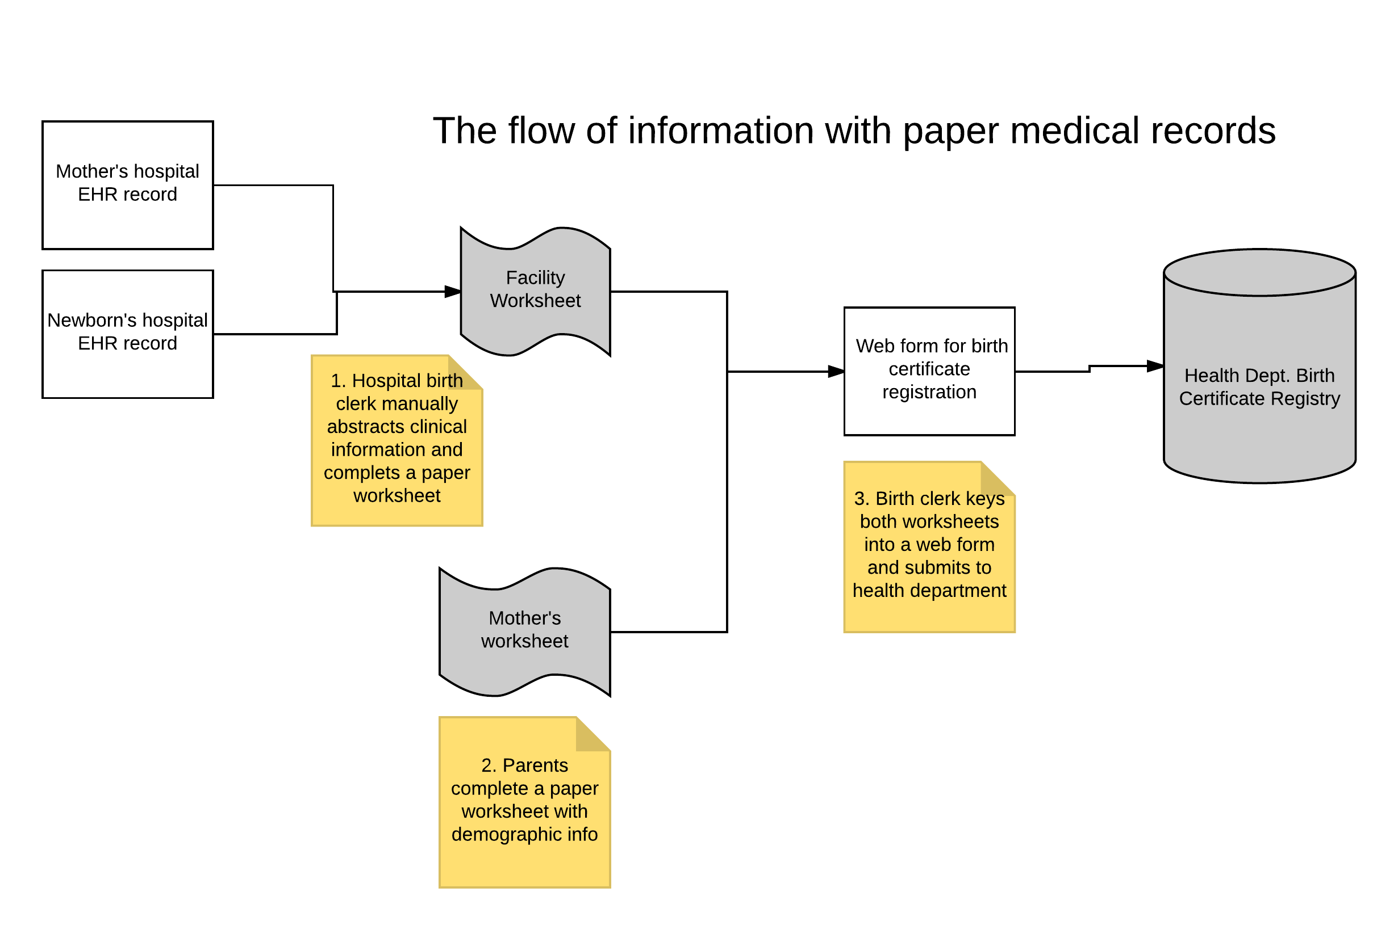
Architectural Diagram
Image was provided by Dr. Ducan

Slide 4
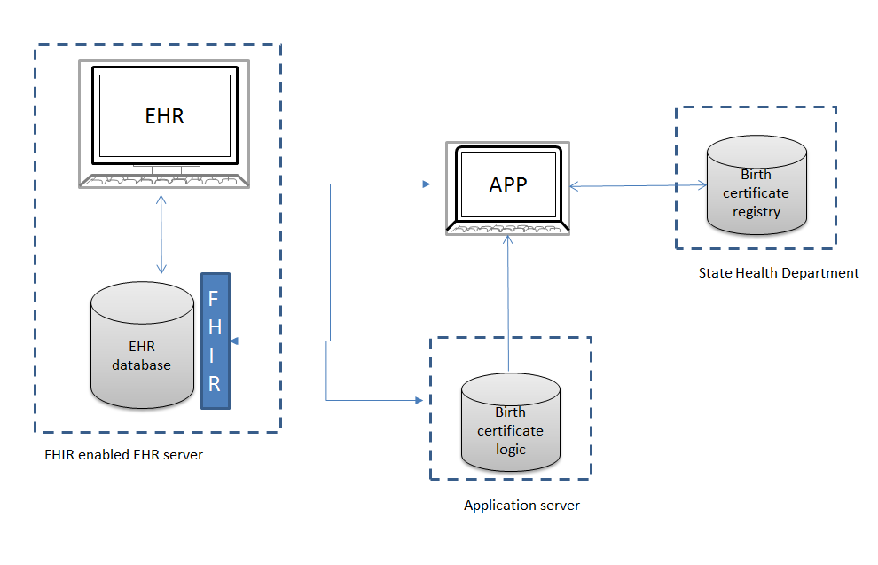
Project Overview
Steps:
Choose a subset of birth certificate information after reviewing the standard birth certificate.
Map birth certificate data elements for each discrete subset identified in (1) to FHIR resource definitions.
Develop logic for the application to translate EHR values to birth certificate values.
Develop a SMART-on-FHIR module with logic specific to the subset that will either pre-populate the birth form or otherwise provide the birth clerk with decision support.
Image was provided by Dr. Ducan

Slide 5
Progress
Designed Website :
Use HTML to setup the main page of the app
The authorized user need to register and set up an account
Identified app workflow
Started to prepare Database (ongoing task)

Slide 6
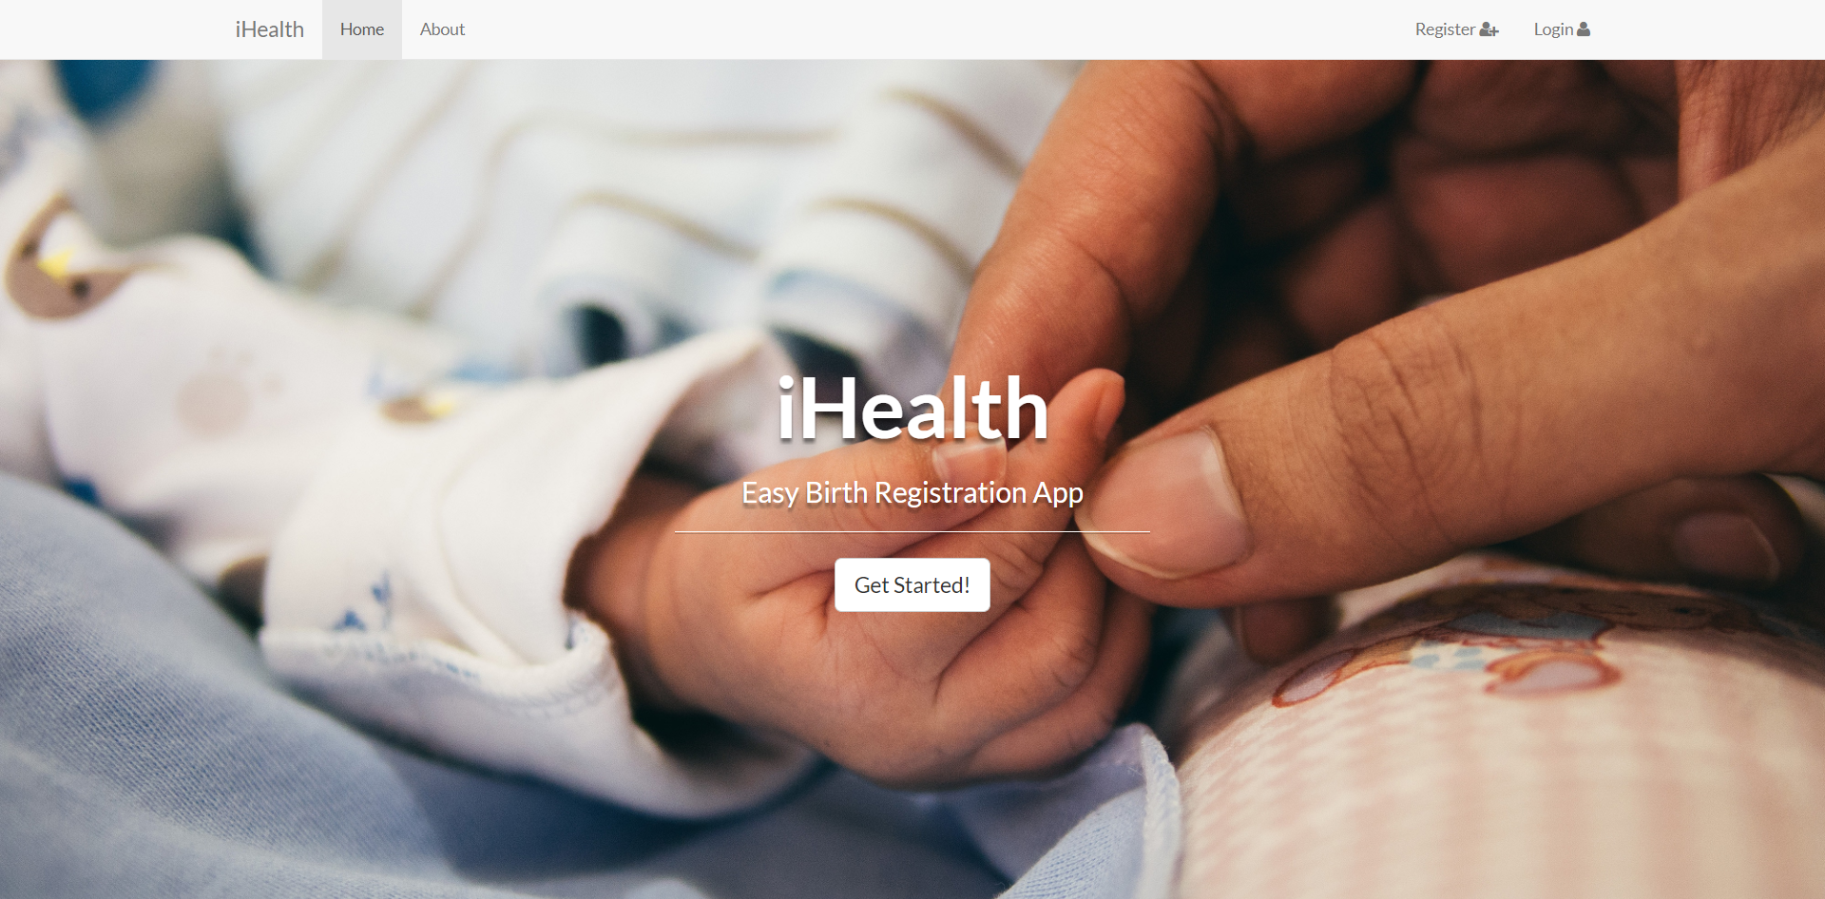
Web Design

Slide 7
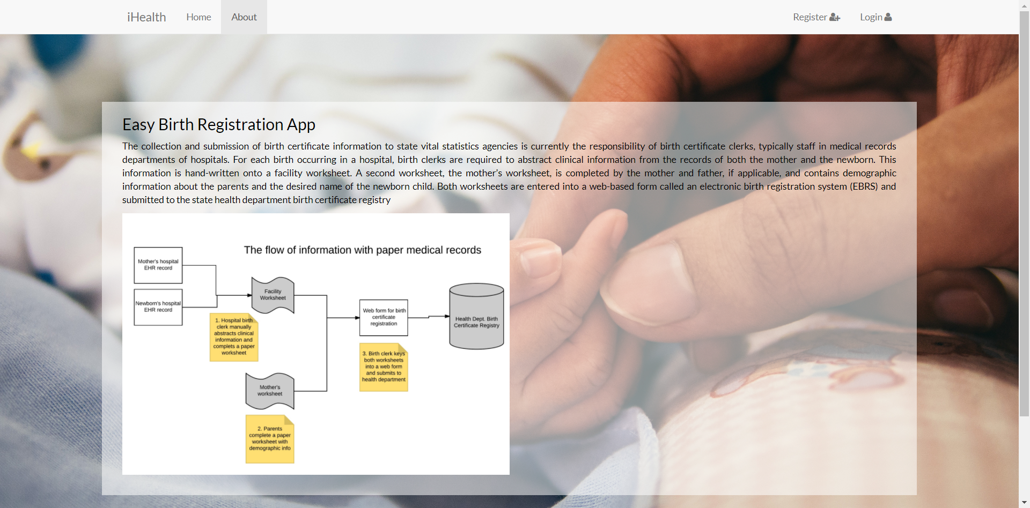
Web Design

Slide 8
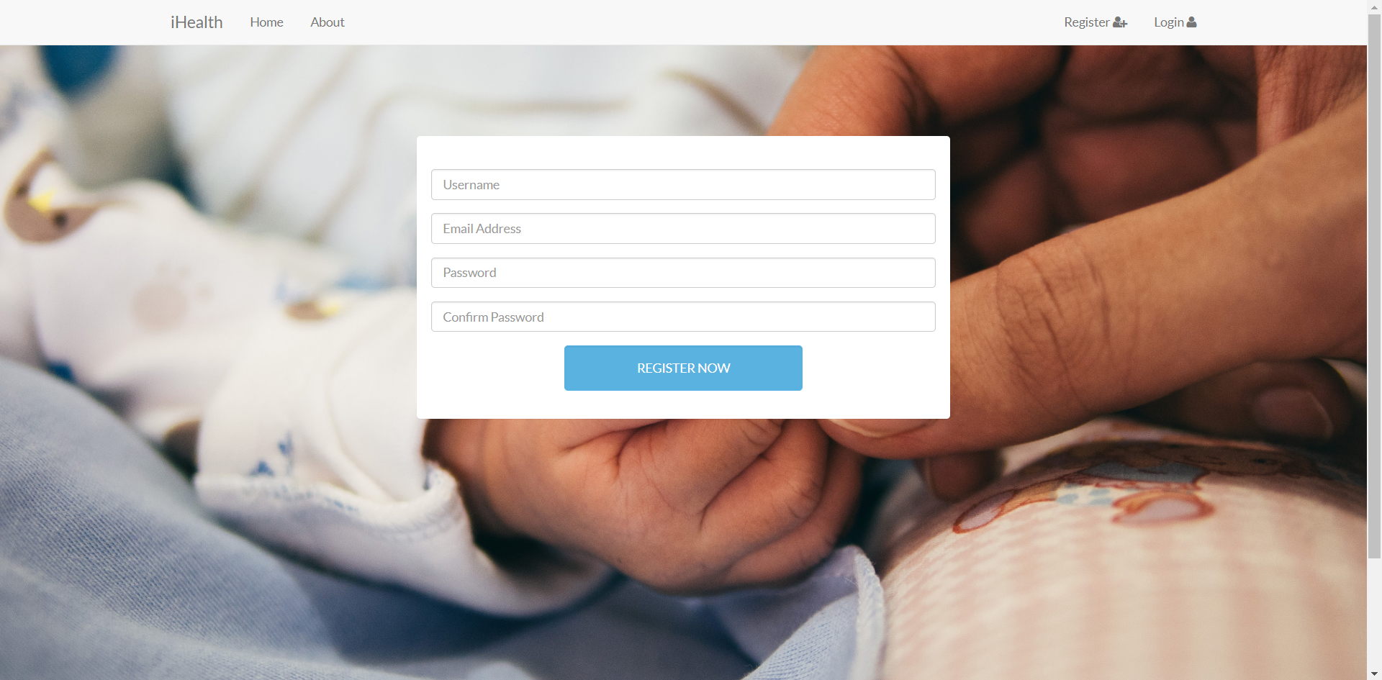
Web Design

Slide 9
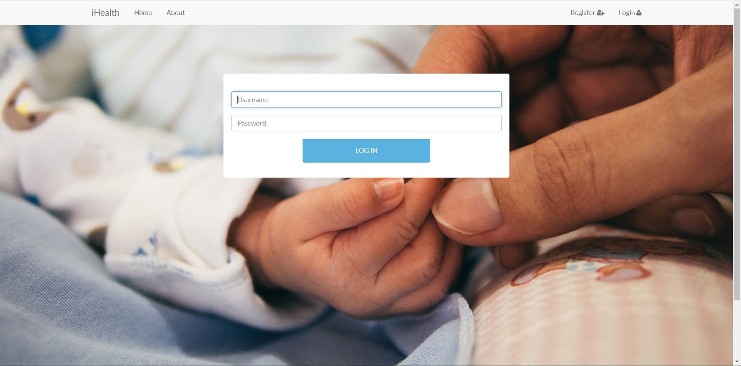
Web Design

Slide 10
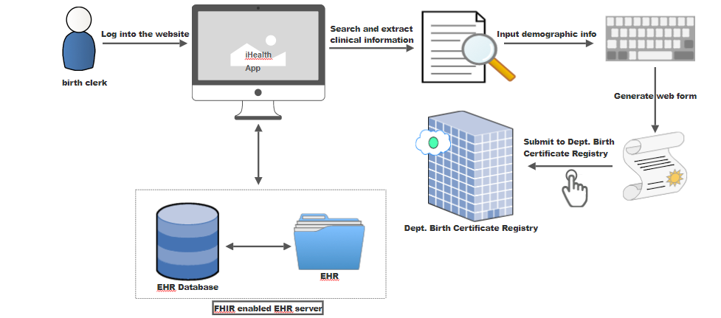

General Workflow

Slide 11
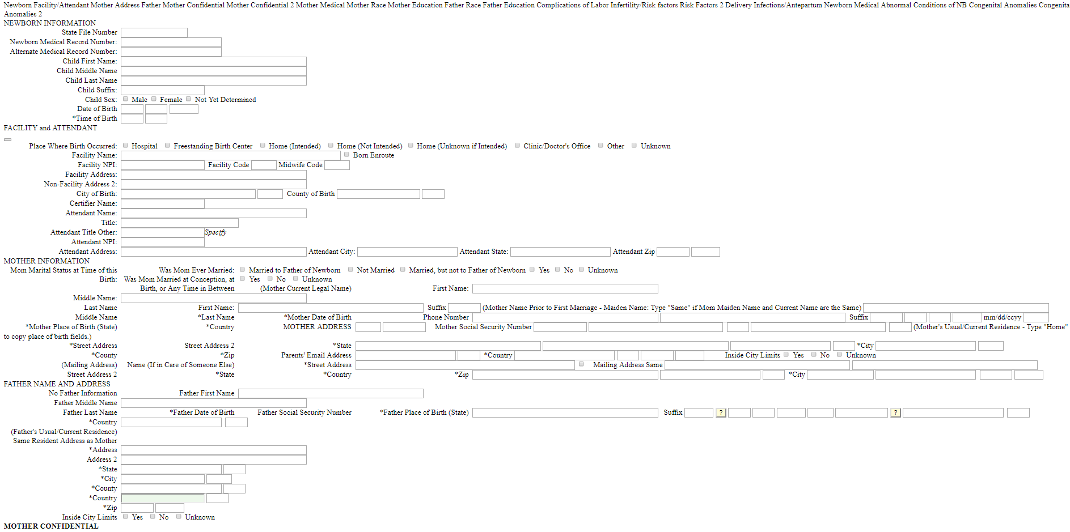
Database Preparation: Data selection

Slide 12
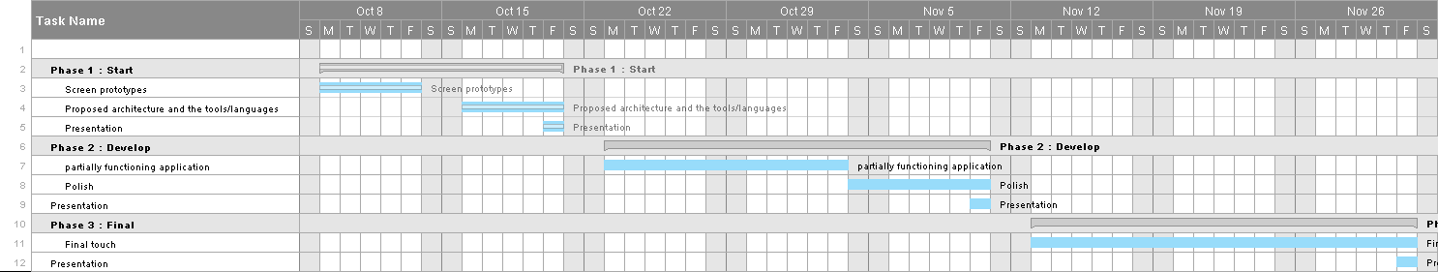
Gantt chart

Slide 13
Thank you! -Team iHealth

Slide 14
